Slide 1
Customer Lead
Prediction
By
G.Arivazhagan
MBT7

Slide 2
Over View of the Project
Domain:
Ed-Tech (Education Technology)
Problem to be Answered:
Which leads are most likely to convert into paying customers?
How can the platform prioritize and allocate resources to leads with the highest conversion potential?
What marketing and sales strategies can be tailored to specific lead segments?
How can the lead management process be streamlined and made more effective?

Slide 3
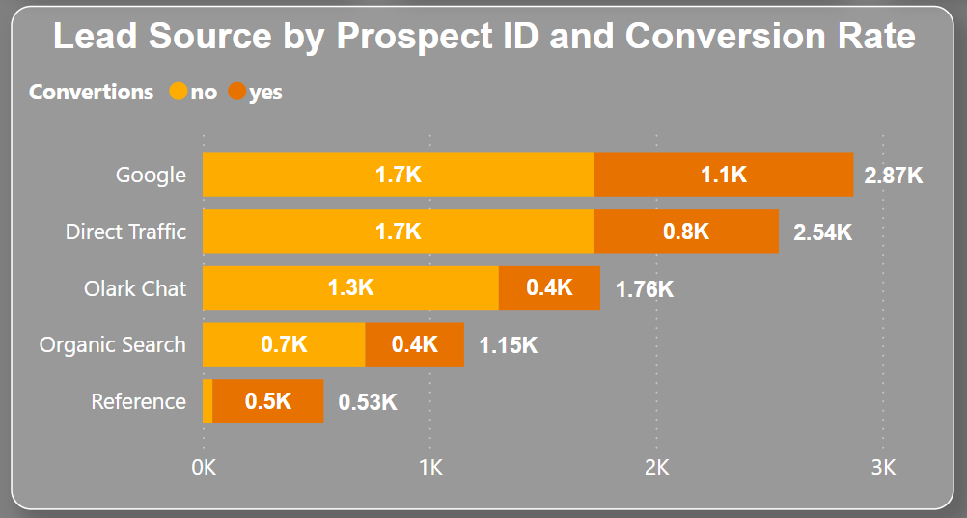
Top Performing ad Source
How can the platform prioritize and allocate resources to leads with the highest conversion potential?
Here we can see we got out most of our trafic by Google
In Google we 2.87K in traffic and 1.1K has bee in converted. which approximately 38.33% conversion rate
Followed by Direct traffic, 2.54K in traffic and an the conversion rate is approximately 31.50%
An Important point to note is Reference traffics with an 0.53K but with an highest conversion rate of 0.5K which led to an conversion rate of 94.34%
The high conversion rate in Reference suggests that our customers are highly satisfied with our Edu-Tech services and are enthusiastic about referring others to our company or the benefits could be good too.

Slide 4
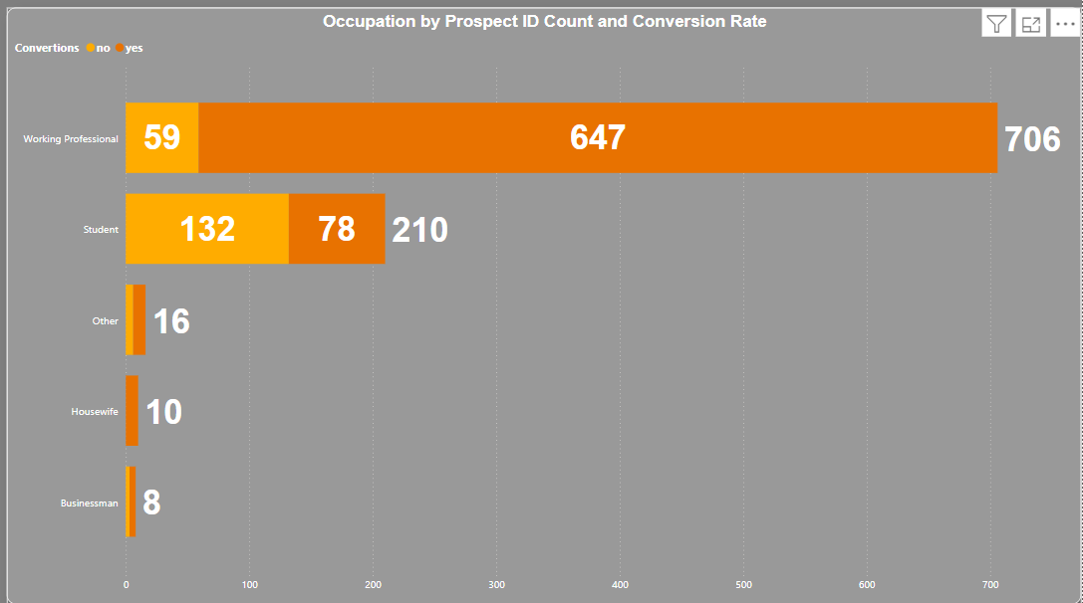
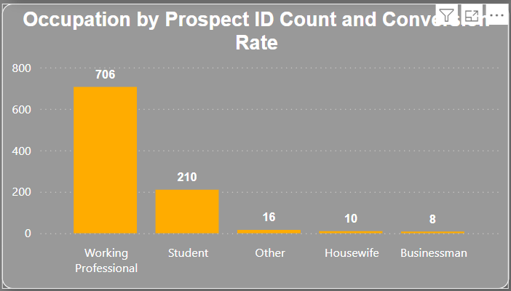
Top Performing ad Source
What marketing and sales strategies can be tailored to specific lead segments?
Here we can Working Professional a are Showing more inters towards these course.
And out of 706 Leads 647 of them have been converted which is approximately 91.64%
At the second place we have Students with 210 leads and 78 converted with an approximately 37.14% of conversion rate.
An Important point to note is housewife with an 10 leads and every one converted.
Changing our perspective on marketing could be beneficial for the company.
For targeting Working professional we can shrink our age demographic to 18 – 35 Which would potentially cover both students and working Professional.
And running an detracted campaign for women who are married and has an college degree could be a good start for targeting house wife.

Slide 5
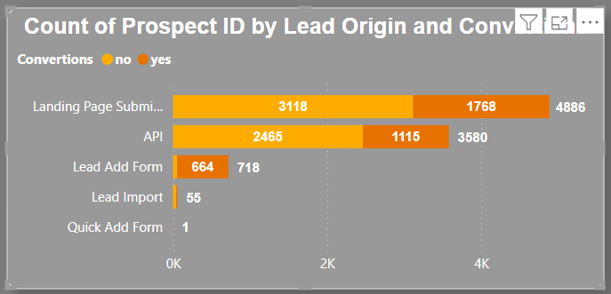
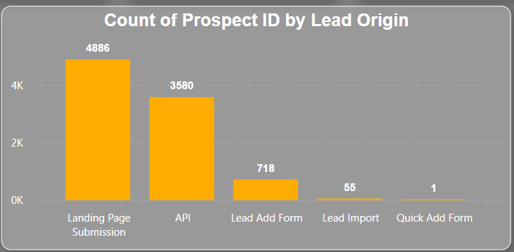
Top Lead Origin
Since we are receiving substantial traffic to our webpage, it's encouraging to see a significant number of leads. The conversion rate is approximately 36.19%, which is a positive indicator of our engagement effectiveness.
API indicates it could be an Application, generating a total of 3580 leads with an approximate conversion rate of 31.15%, resulting in 1115 conversions.
Lead Add Form is useful for gaining insights into leads and tailoring our marketing strategies based on the responses in the forms to generate better leads. By customizing our pitch to meet their needs, we can achieve better conversions.
We received 718 leads through the Lead Add Form, and 664 of these have been converted, resulting in an approximate conversion rate of 92.48%.

Slide 6
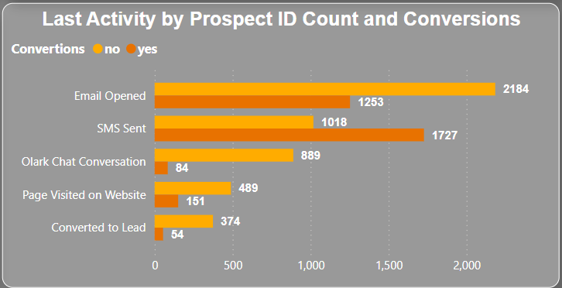
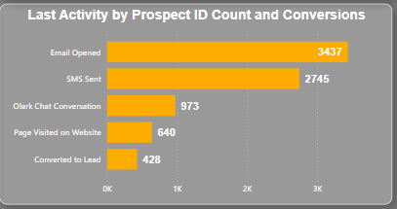
Last Activity
Email Opened in total is 3437 and out of them 1253 is converted Which is approximately 36.46% .
SMS Sent has an high conversion rate compared to other total lead by SMS sent is 2745 which is approximately 68.78%.
Followed by that page visited on website has high convertion too.
Building a strong connection with the customer is beneficial as it allows us to gather valuable information and tailor our marketing strategies to match the customer's preferences.

Slide 7
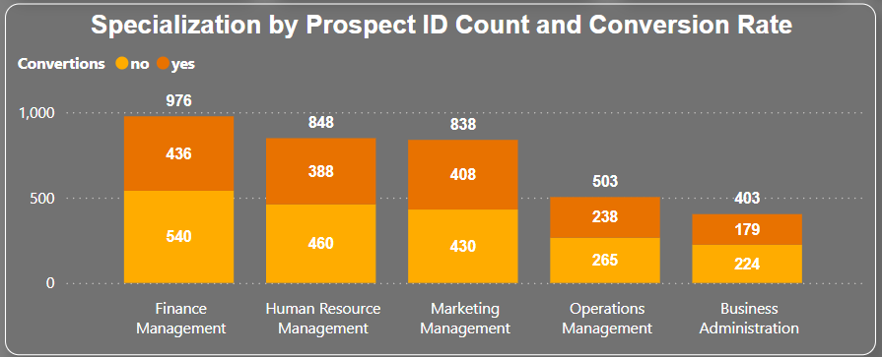
Last Activity
What marketing and sales strategies can be tailored to specific lead segments?
People related to Finance Management show a greater interest in our Edu-Tech platform compared to others. Out of 976 leads, 436 have been converted, which is approximately 44.67%.
Followed by HR management, which has an approximate conversion rate of 45.75%.
Marketing management, which has an approximate conversion rate of 48.69%.
By analyzing the industries from which our leads are coming, we can tailor our courses to suit our audience's interests. This customization will help engage our audience more effectively and meet their specific needs.

Slide 8
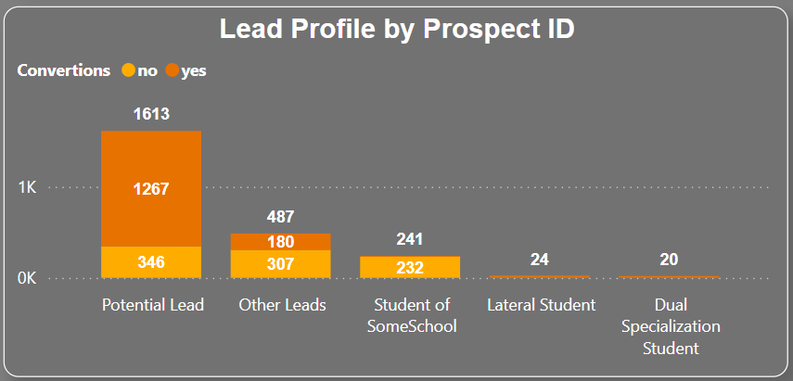
Lead Profile by Prospect ID
Focusing on Potential leads can help us improve our already strong conversion rate, currently at 78.55%, saving us time and effort.
Additionally, we should prioritize lateral students and those with dual specializations Student.
Recommendation: Gathering more information from potential leads will provide deeper insights, allowing us to better understand customer perspectives and preferences.

Slide 9
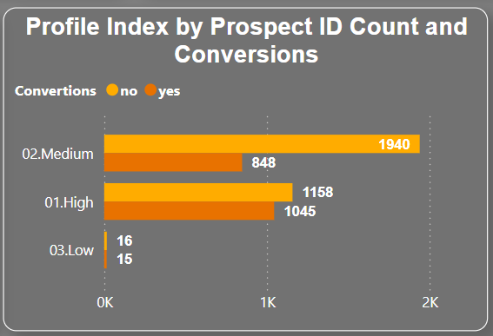
Profile Index by prospect ID count and conversions
This chart shows that focusing on High conversion rates will help us concentrate on the most potential leads.
We received High 1158 leads, and 1045 were converted, resulting in an approximate conversion rate of 90.24%.
After completing high move to medium because it also has an high potential chance to convert.

Slide 10
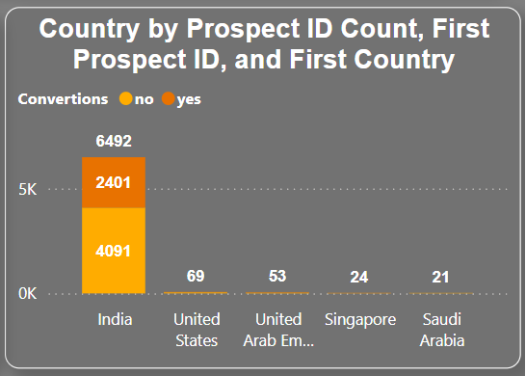
Country by Prospect ID and Convertion
What marketing and sales strategies can be tailored to specific lead segments?
This chart shows that India is the primary target for the company.
Since India is a diverse country, we can use vernacular languages to attract and better connect with the local audience. India has a conversion rate of 36.93%.
Although our Edu-Tech services can be expanded to other countries, focusing on and improving the conversion rate in India will provide a significant advantage.
Additionally, the cost of acquiring leads in India is lower compared to other countries, making it a strategic area for growth.

Slide 11
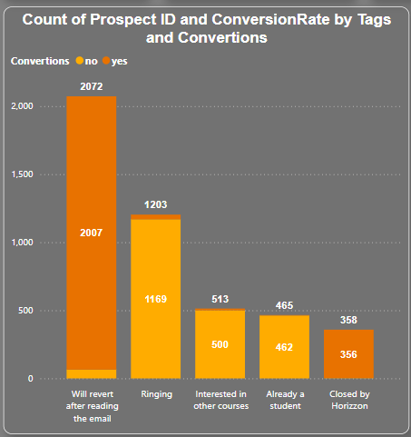
Count of Prospect ID and Conversion Rate by Tags and Convertion
This chart explains customer behavior. We can see that leads who indicate they will "Will revert after reading the email" are converted at a higher rate compared to others.
Specifically, the "Will revert after reading the email" tag has an approximate conversion rate of 96.86%
Additionally, the "Closed by Horizon" tag also shows a high conversion rate.

Slide 12
Signs for potential leads
Which leads are most likely to convert into paying customers?
Based on the our previous, here are the key high-performing scenarios to highlight:
1. Top Performing Ad Source
Google: Generated 2.87K leads with a conversion rate of approximately 38.33%.
Direct Traffic: Generated 2.54K leads with a conversion rate of approximately 31.50%.
Reference Traffic: Although it generated only 0.53K leads, it had the highest conversion rate of approximately 94.34%.
2. Top Lead Origin
Lead Add Form: Generated 718 leads, with 664 converted, resulting in a conversion rate of approximately 92.48%.
API: Generated 3580 leads with an approximate conversion rate of 31.15%, resulting in 1115 conversions.
3. Last Activity
SMS Sent: Generated a total of 2745 leads with an approximate conversion rate of 68.78%.
Email Opened: Generated 3437 leads, with 1253 converted, resulting in an approximate conversion rate of 36.46%.

Slide 13
Signs for potential leads
4. Lead Profile by Prospect ID
Potential Leads: Focus on these leads resulted in a strong conversion rate of 78.55%.
High Potential Leads: Received 1158 leads, with 1045 converted, resulting in a conversion rate of approximately 90.24%.
5. Country by Prospect ID and Conversion
India: Primary target for the company with a conversion rate of 36.93%. The cost of acquiring leads in India is lower, making it a strategic area for growth.
6. Tags and Conversion
Will Revert After Reading the Email: This tag has an approximate conversion rate of 96.86%.
Closed by Horizon: This tag also shows a high conversion rate.
These insights highlight the areas where the company is performing well and where to focus efforts for further improvement.

Slide 14
How can we avoid human error
How can the lead management process be streamlined and made more effective?

Slide 15
ML model
Why ML model
Building an ML model with this data and ranking the leads will streamline the marketing process, reduce human error in assessing lead quality, and increase the pursuit of high-quality leads.
Therefore, we built an ML model using Jupyter Notebook.
There are few rules to follow.
The column names in the current data should also be present in the new data.
Ensure that the wording and spelling of the column names are consistent.
Make sure the data is clean and ready to use.
Points to Remember
There is no such thing as 100% convertible leads.
Each lead has a 50/50 chance of converting.
By using this ML model, we can improve the odds, refining the prediction from 50/50 to 60/40 or 70/30 depending on the available data.
The accuracy of the model is between 70-85%.
The main focus is to reduce human errors as much as possible.

Slide 16
Thank You
By
G.Arivazhagan
MBT7

